Slide 1
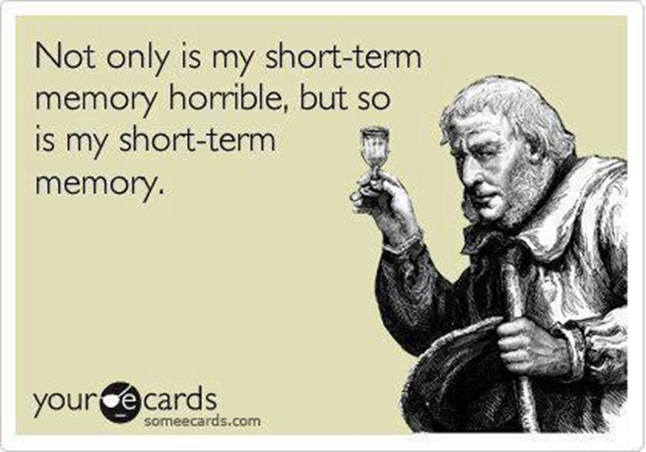
Chapter 8 Memory

Slide 2
Brain and Memory
The Amygdala
Regulates emotions, such as fear and aggression
Responsible for emotion memories.
Involved in memory consolidation: the process of transferring new learning into long-term memory.

Slide 3
Brain and Memory
The Hippocampus
Important in memory processing, specifically recognition memory and spatial memory.
Projects information to cortical regions that give memories meaning.
Plays a part in memory consolidation

Slide 4
Brain and Memory
The Cerebellum and Prefrontal Cortex
Cerebellum: implicit memory (e.g. procedural memory, motor learning)
Frontal cortex: associated with memory encoding and retrieval.

Slide 5
Brain and Memory
Neurontransmitters:
e.g., dopamine, glutamate, serotonin, etc.
We don’t yet know which role each neurotransmitter plays in memory.
Arousal Theory (Christianson, 1992): strong emotions trigger the formation of strong memories, and weaker emotional experiences form weaker memories.

Slide 6
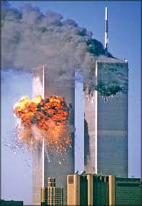
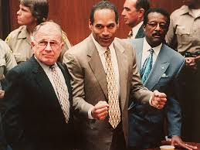
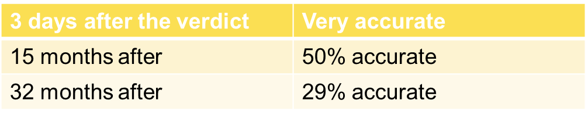
Flashbulb memory
An exceptionally clear collection of an important event
Where were you when you first heard about the 9/11 attack?
Subject to distortion!
Where were you and what were you doing when you heard about the not-guilty verdict in O.J. Simpson murder trial?

Slide 7

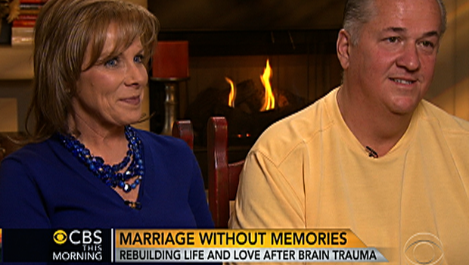
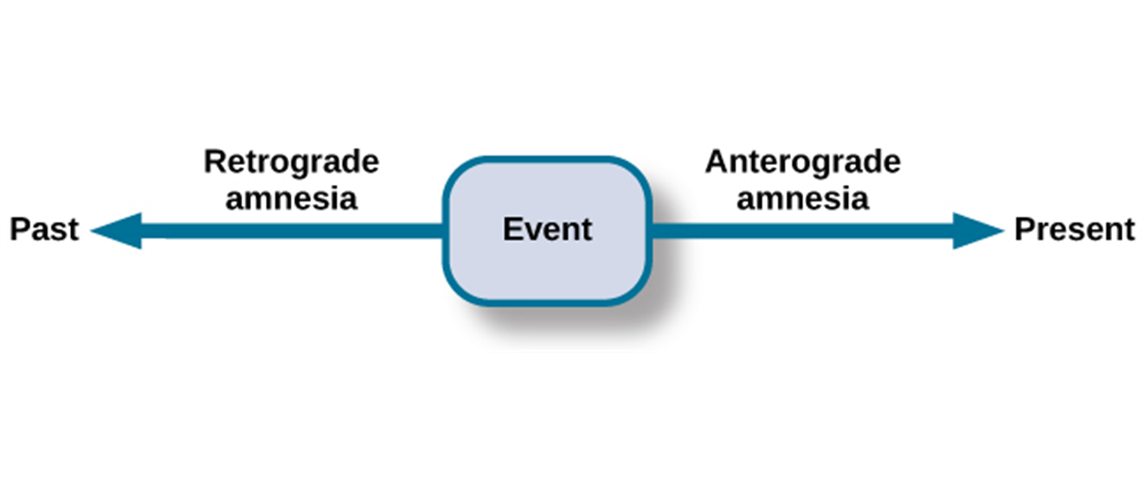
Brain Damage and Memory
Anterograde amnesia: cannot remember new information
Hippocampus usually affected
Inability to consolidate memories
Retrograde amnesia: cannot remember anything occurred prior to the damage
- Difficulty remembering episodic memories

Slide 8
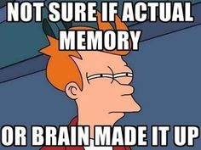
Memory Construction and Reconstruction
Why our memories can be unreliable?

Slide 9
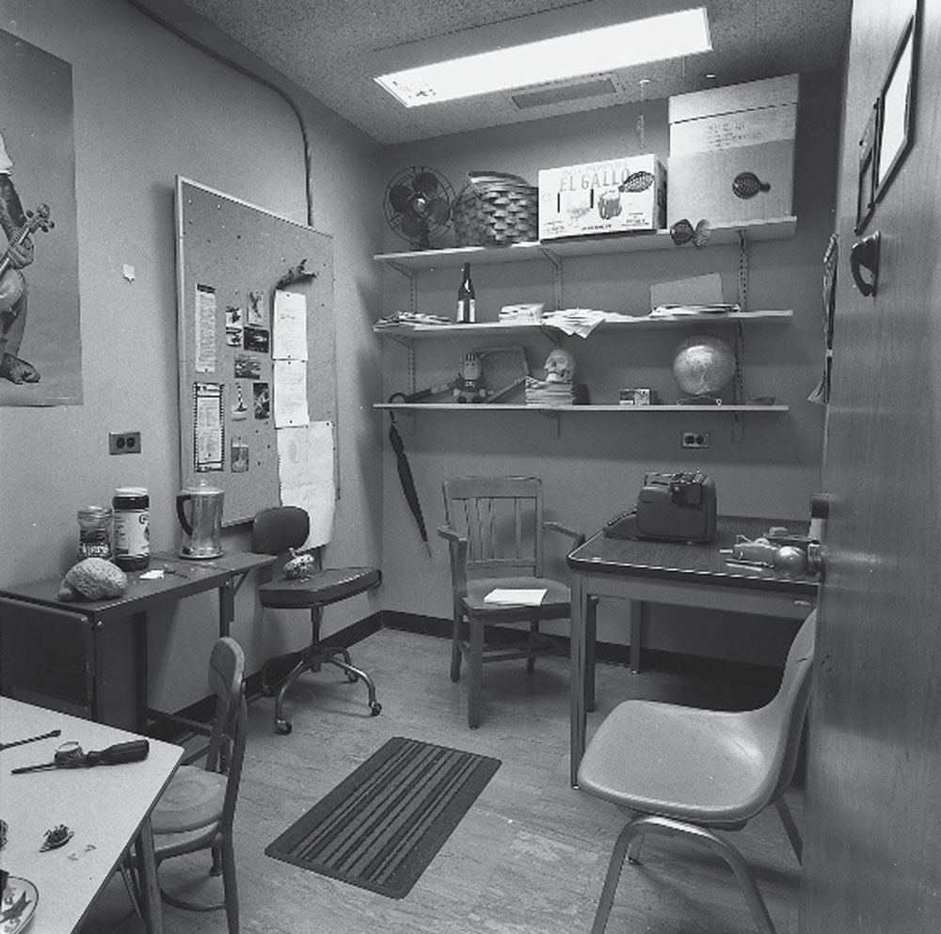
Try This
Study this photograph
Did you see the:
chair?
wastebasket?
bottle?
typewriter?
coffeepot?
book?
There was no book or wastebasket.
If you saw them, how would you explain that?

Slide 10
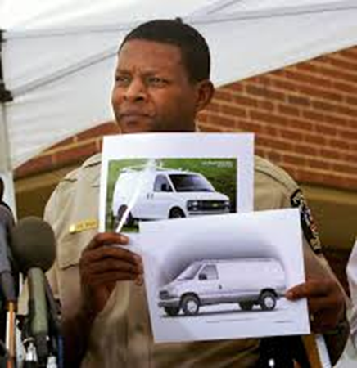
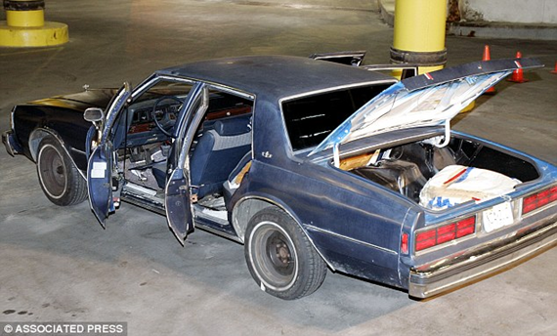
Suggestibility
Memories can be easily misled due to the problem of suggestibility.
Suggestibility: the effects of misinformation from external sources that leads to the creation of false memories.
Consider the case of the DC Sniper

Slide 11
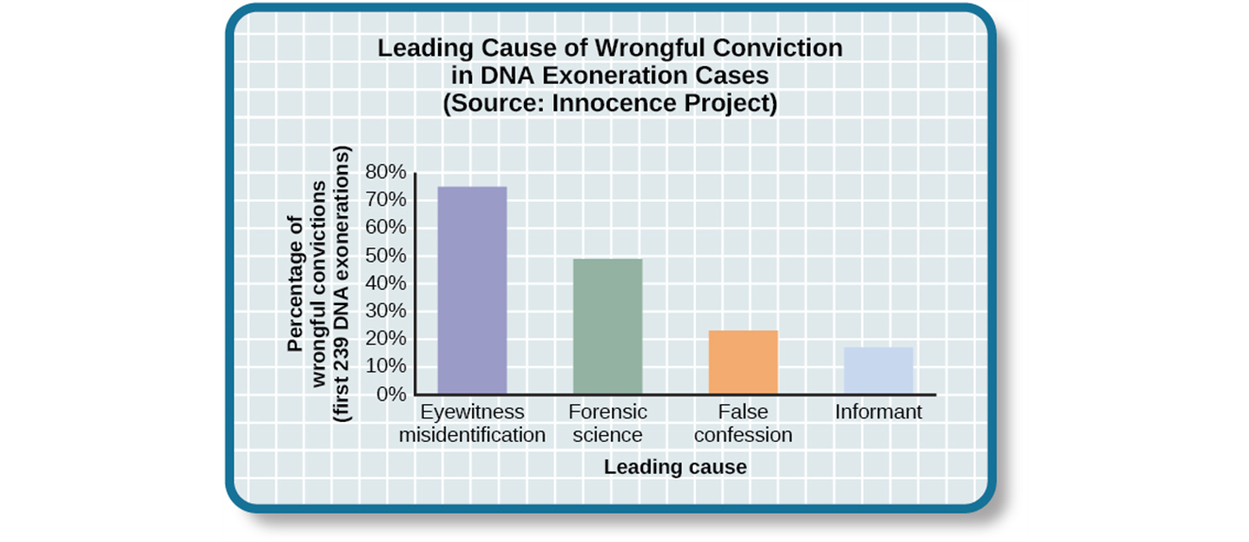
Eyewitness Identification
Eyewitness testimony can be weakened by lineups.
In studying cases where DNA evidence has exonerated people from crimes, the Innocence Project discovered that eyewitness misidentification is the leading cause of wrongful convictions (Benjamin N. Cardozo School of Law, Yeshiva University, 2009).

Slide 12
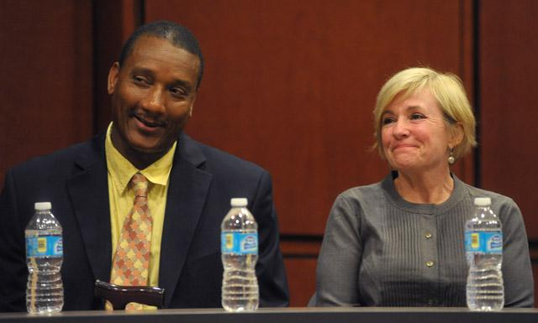
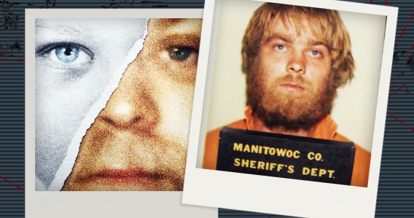
Eyewitness Identification
Jennifer Thompson and Ronald Cotton

Slide 13
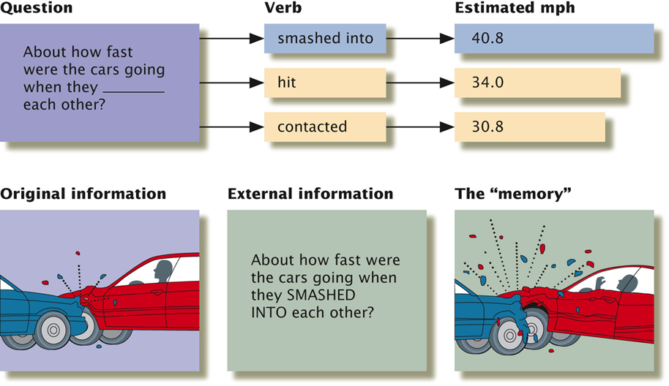
The Misinformation Effect
After exposure to incorrect information, a person may misremember the original event.

Slide 14
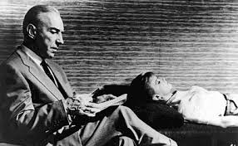
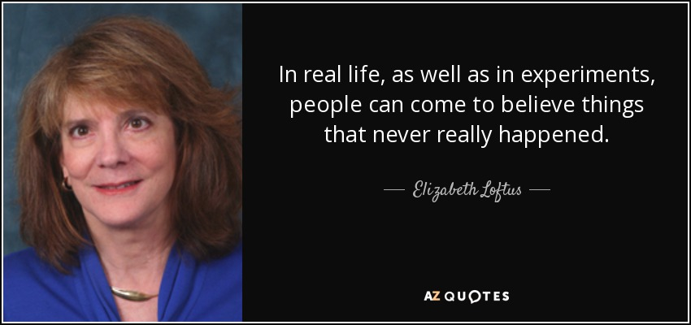
Repressed and Recovered Memories
Debate on whether the memories of traumatic events (e.g., sexual abuse) could be repressed.
Repressed memories can be locked away for decades and later recalled intact through hypnosis and guided imagery techniques.
Loftus and others are skeptical of the questioning process used to access these memories, which can lead to misinformation effects.

Slide 15
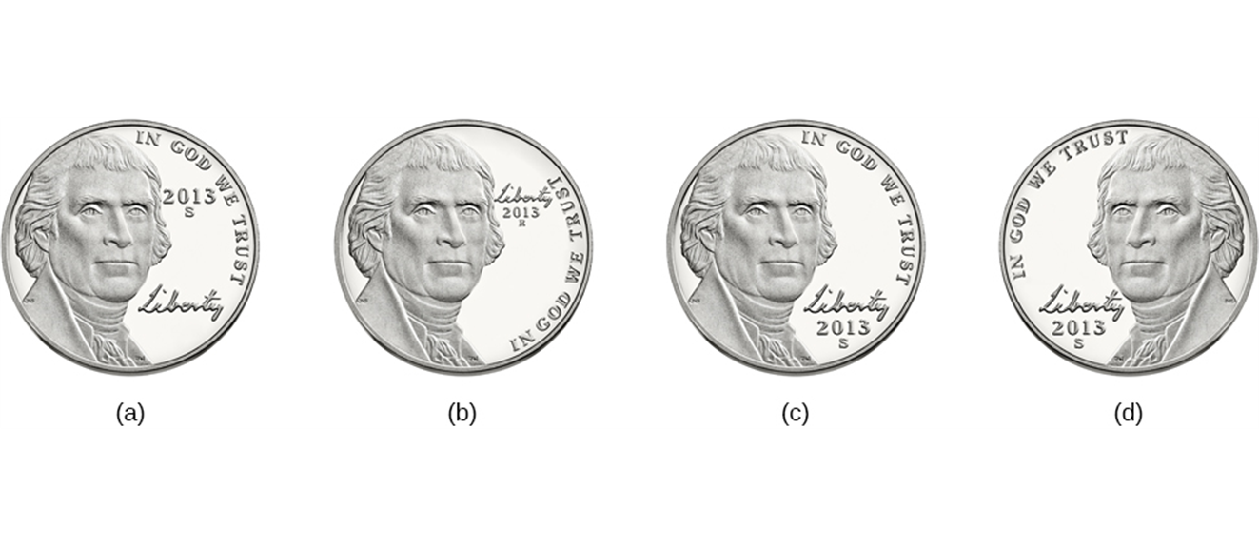
FORGETTING
Encoding Failure
Memory loss happens before the actual memory process begins

Slide 16
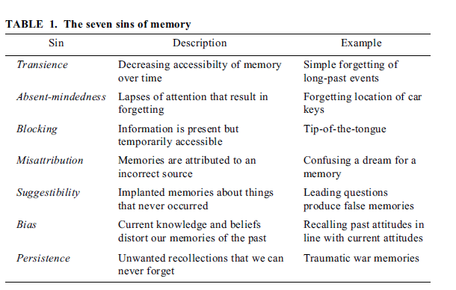
Memory Errors

Slide 17
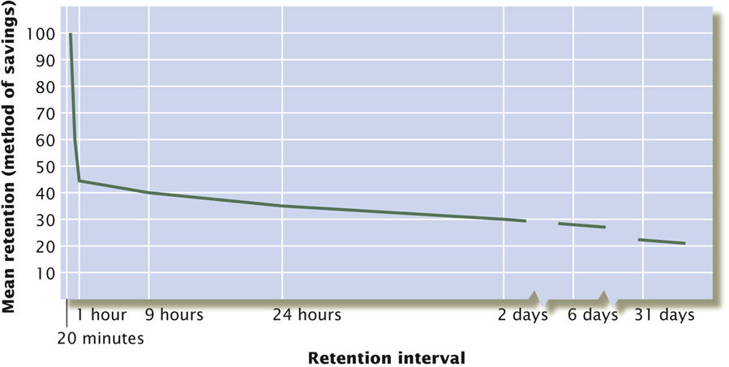
Memory Errors
Hermann Ebbinghaus: Ebbinghaus forgetting curve
Shape of the forgetting curve
Most information is lost in the first few hours after learning
Savings left in long term memory can last for decades

Slide 18

Memory Errors
Absentmindedness: lapses in memory caused by breaks in attention or our focus being somewhere else.

Slide 19
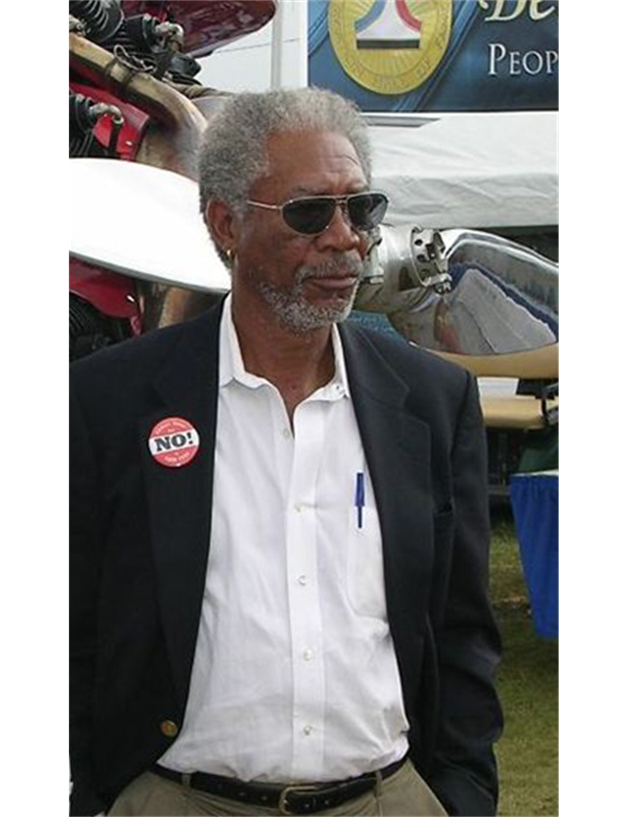
Memory Errors
Blocking: you can’t access stored information
Blocking is also known as tip-of-the-tongue (TOT) phenomenon. The memory is right there, but you can’t seem to recall it

Slide 20

Memory Errors
Misattribution: occurs when you confuse the source of your information.

Slide 21
Memory Errors
Bias: your feelings and view of the world can actually distort your memory of past events.
Persistence: inability to forget about unpleasant events.

Slide 22
Why do we forget?
Interference
Retroactive Inhibition
Old information is displaced by newer information
Proactive Inhibition
Old information hinders the recall of newly learned information

Slide 23
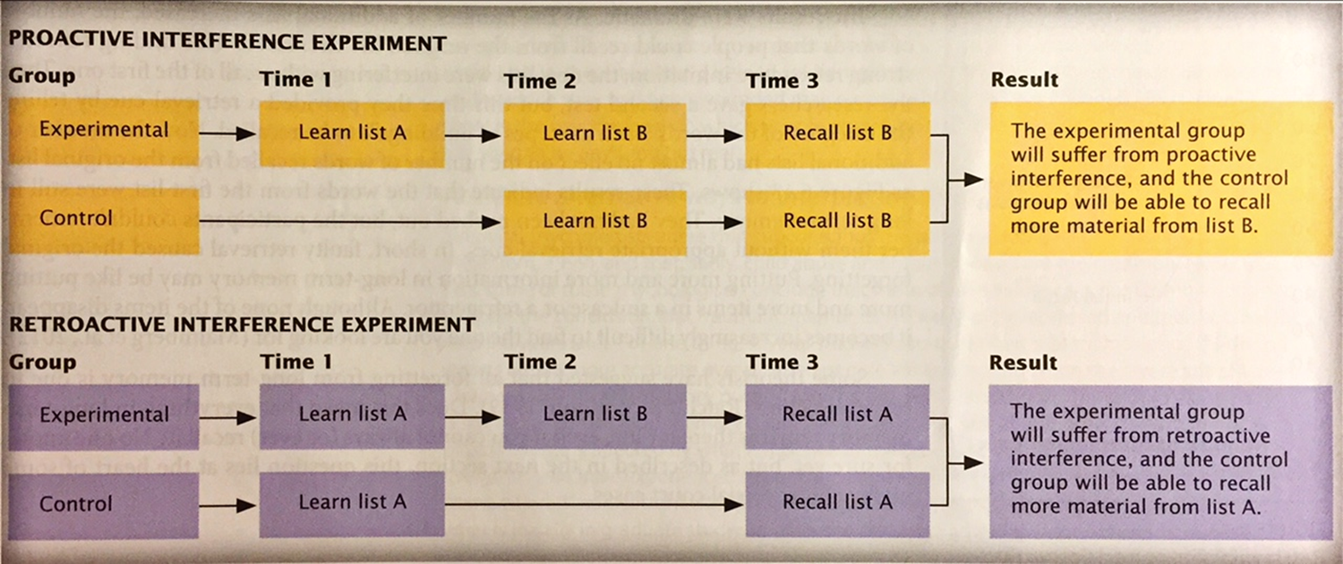
Why do we forget?

